Slide 1

Multi-level Cardiovascular Disease Risk
Natasha Carpio Castellanos, Shawn Li, Jiayu Zhao

Slide 2
Bussiness Case
Global Health Threat
CVD has long been of the world’s leading health threats
Silent High Risk
Imperceptiable
A significant proportion of patients remain asymptomatic untill late stage
Early signs of CVD are often imperceptible, making timely detection before clinical intervention difficult.
Identification Challenge
For care management providers, and telemedicine platforms, accurately identifying high-risk patients before clinical intervention has become a critical challenge.
Notes:
Cardiovascular disease (CVD) has long been one of the world’s leading health threats, and a significant proportion of patients remain asymptomatic until late stages, making them “silent” high‑risk individuals. Because early symptoms are often imperceptible, identifying high‑risk patients before clinical intervention has become a critical challenge for health insurers, care management providers, and telemedicine platforms.

Slide 3
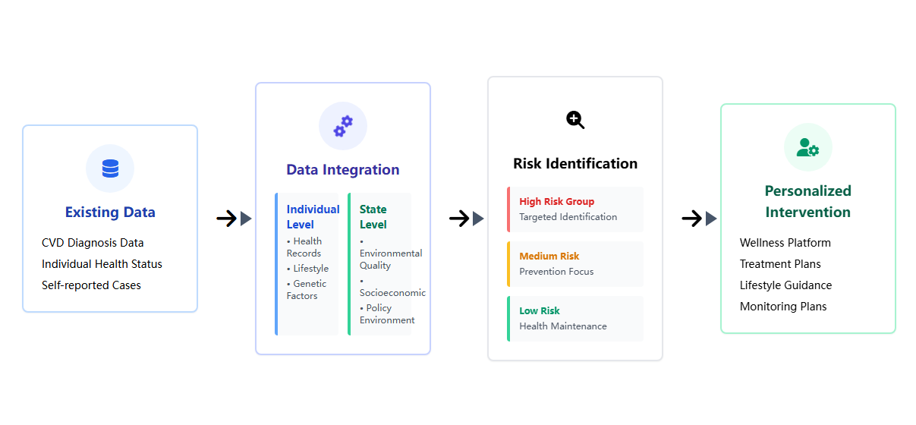
Bussiness Case

Slide 4
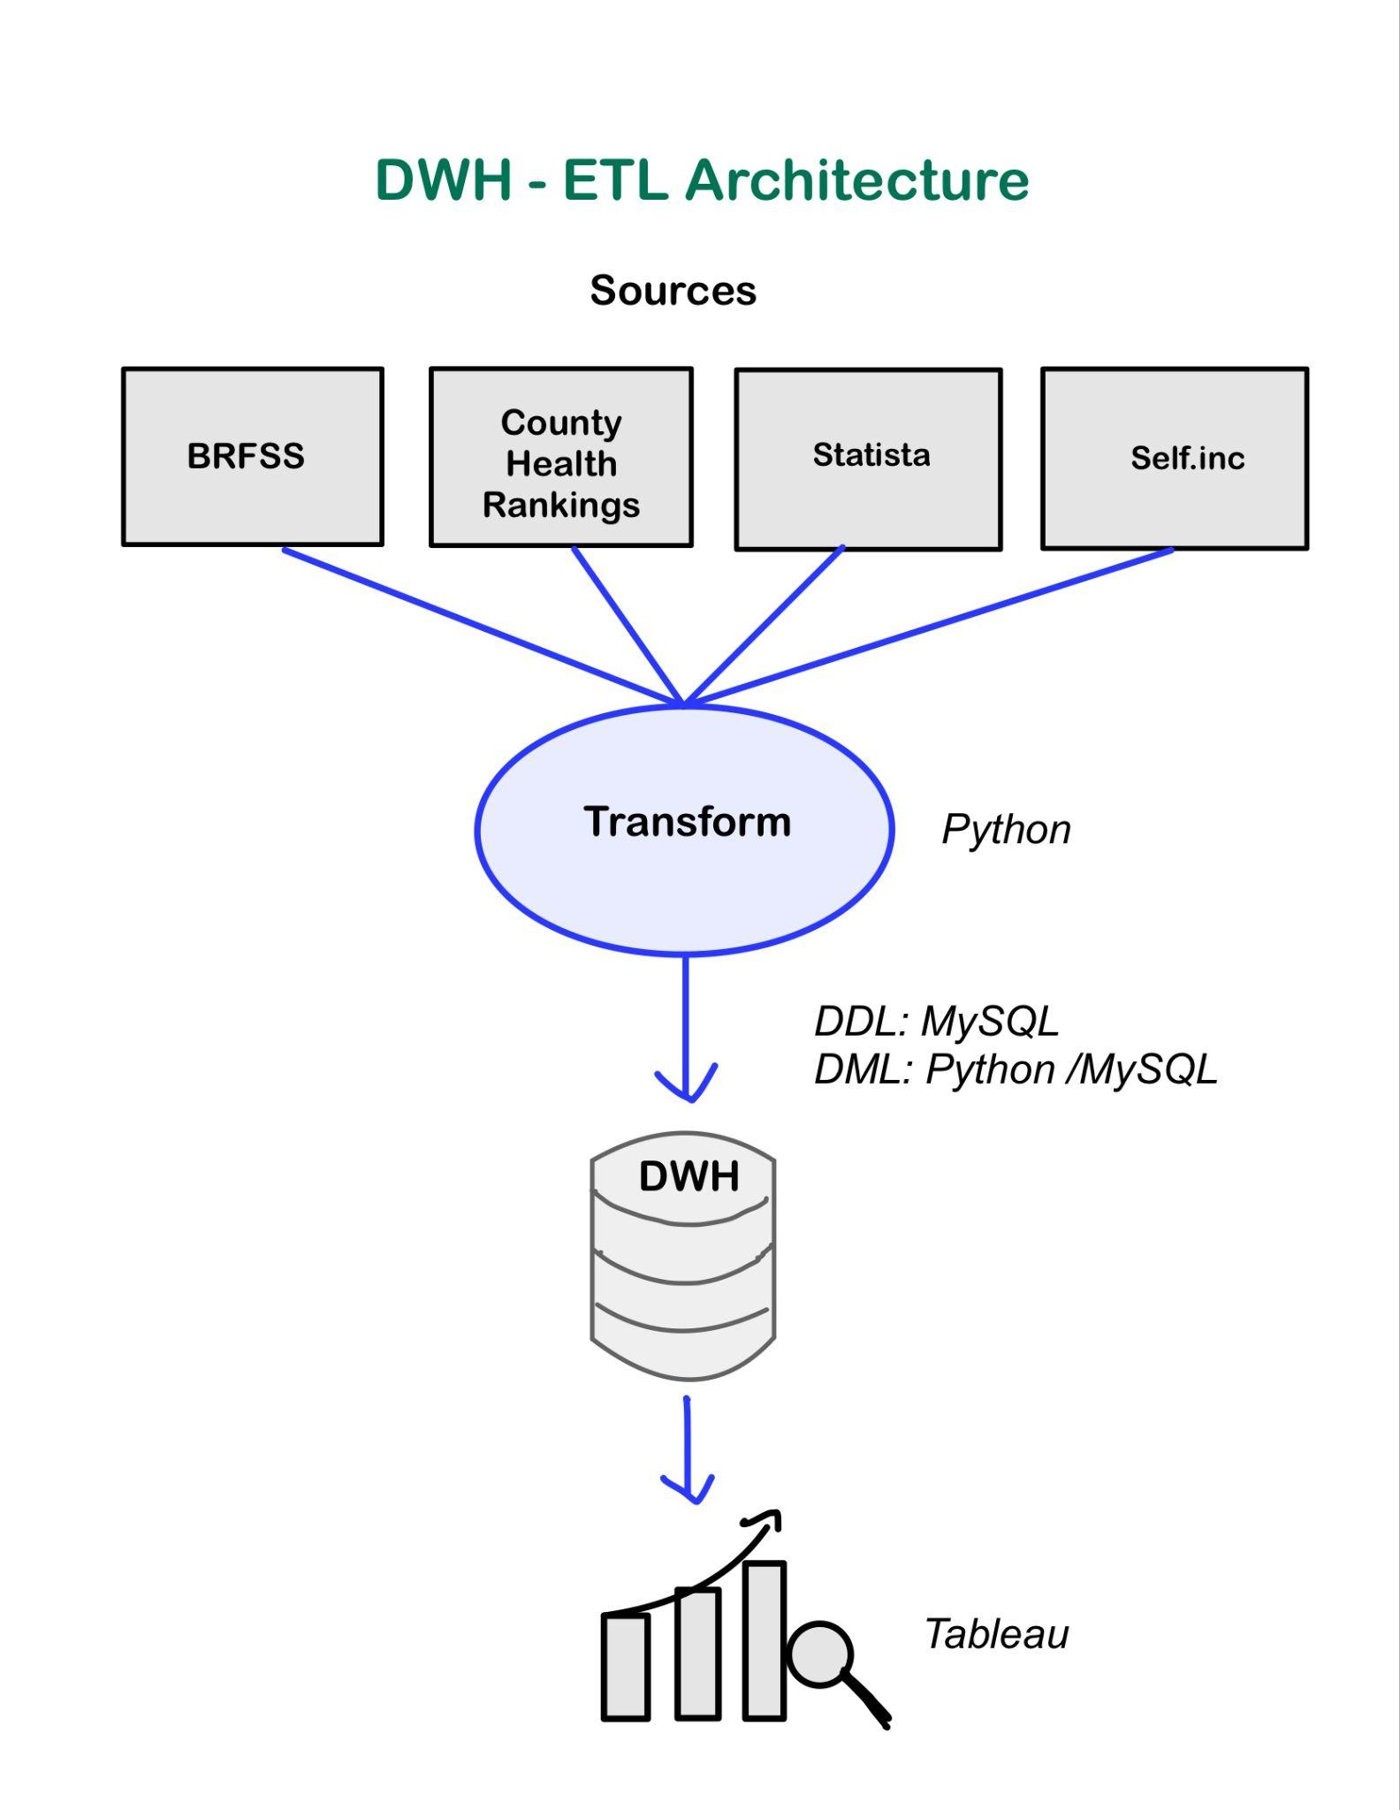
Souce Data and Pipeline
1. Souce Data
BRFSS
County Health Ranking
Statista
Self.inc
2. STTM
Extracts and cleans raw data
Applies any necessary joins, aggregates or feature engineering
3. DWH
Schema (DDL) managed in MySQL
Data loading/manipulation (DML) done via Python scripts and direct MySQL commands
4. BI & Reporting
Tableau Desktop connects to the DWH to deliver dashboards and visualizations
Alternative with Tableau Public: Use a Python script with MySQL commands to convert tables in the database to CSV files per table → Upload CSV files to Tableau

Slide 5
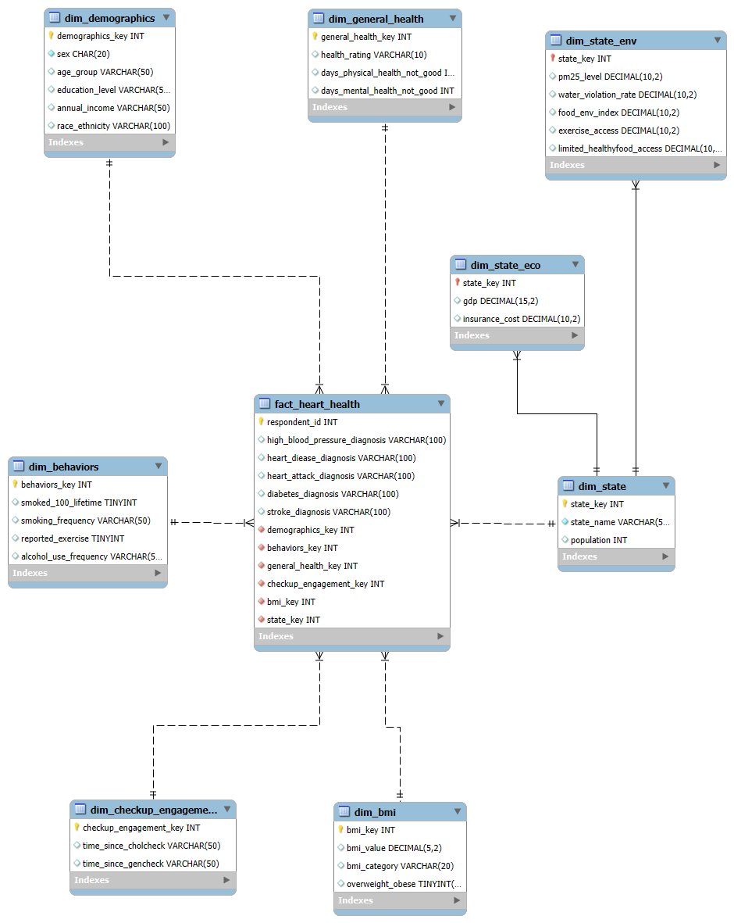
Database Design
Individual level:
dim_demographics: Stores key demographic attributes of each respondent
dim_general_health: Records self-reported overall health status
dim_behaviors: Captures lifestyle and behavior metrics
dim_checkup_engagement: Tracks how long it’s been since a respondent’s last cholesterol check and general medical checkup.
dim_bmi: Contains Body Mass Index measurements
State level:
dim_state: Defines each U.S. state by name and population, serving as the primary state dimension
dim_state_env: Records the environmental metrics at the state level
dim_state_eco: Store the detail economic indicators by state

Slide 6
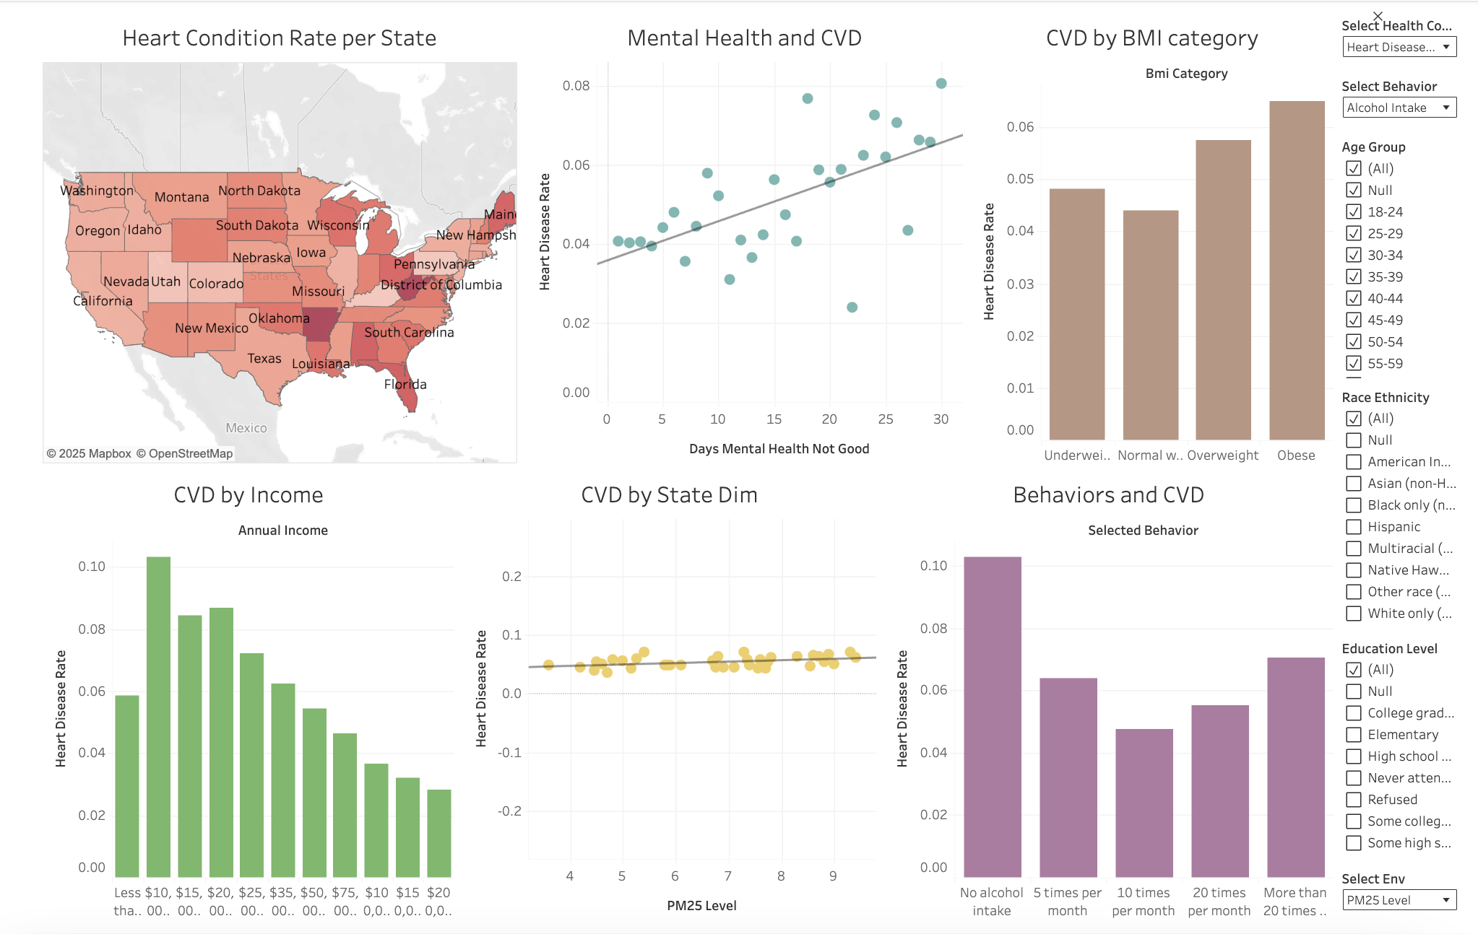
Tableau Reports
https://public.tableau.com/app/profile/zizhan.li8282/viz/CVDRisk_17483262004220/Dashboard1?publish=yes

Slide 7
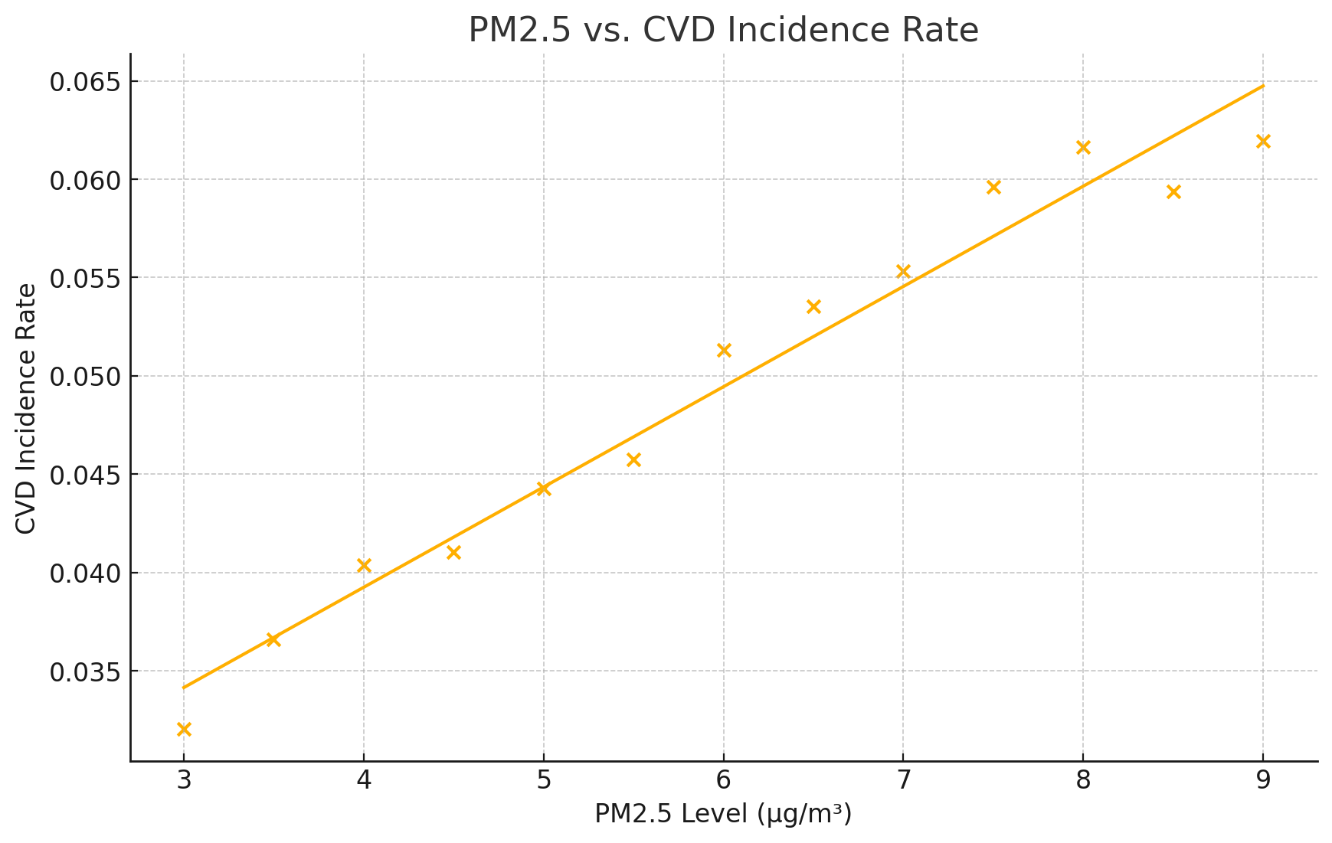
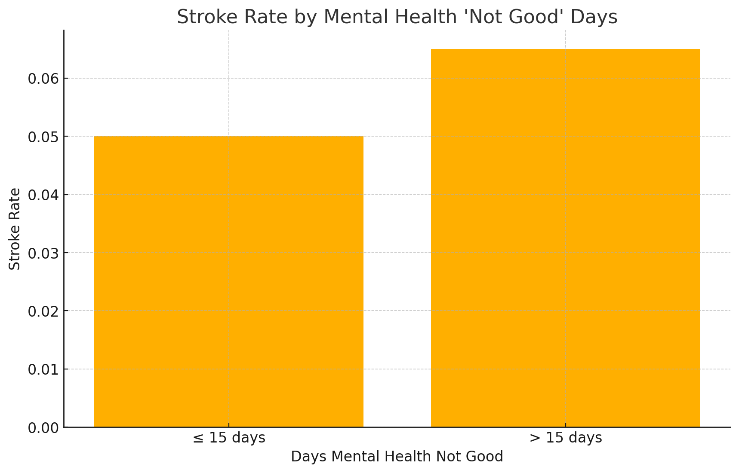
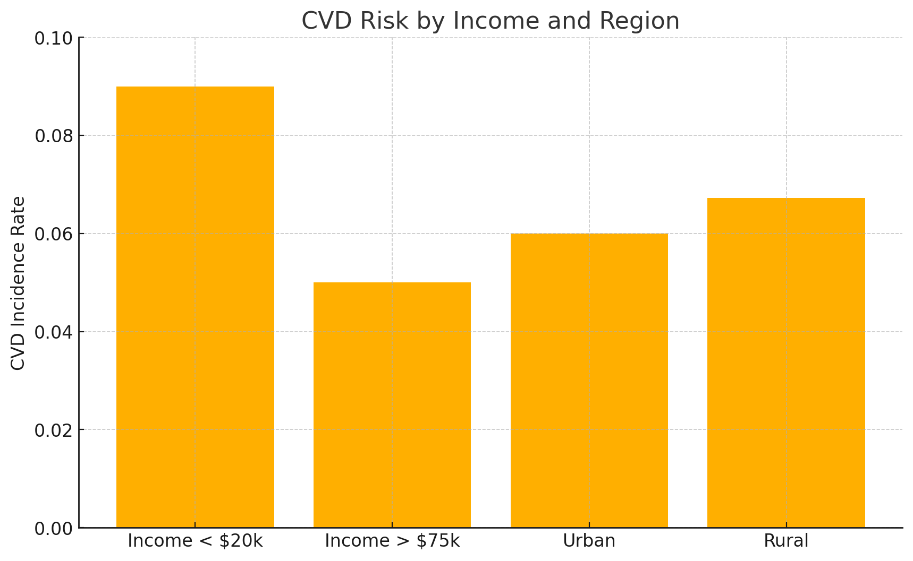
Conclusion
What we found
Significant socio-economic differences
Driven by both the environment and behavior

Slide 8
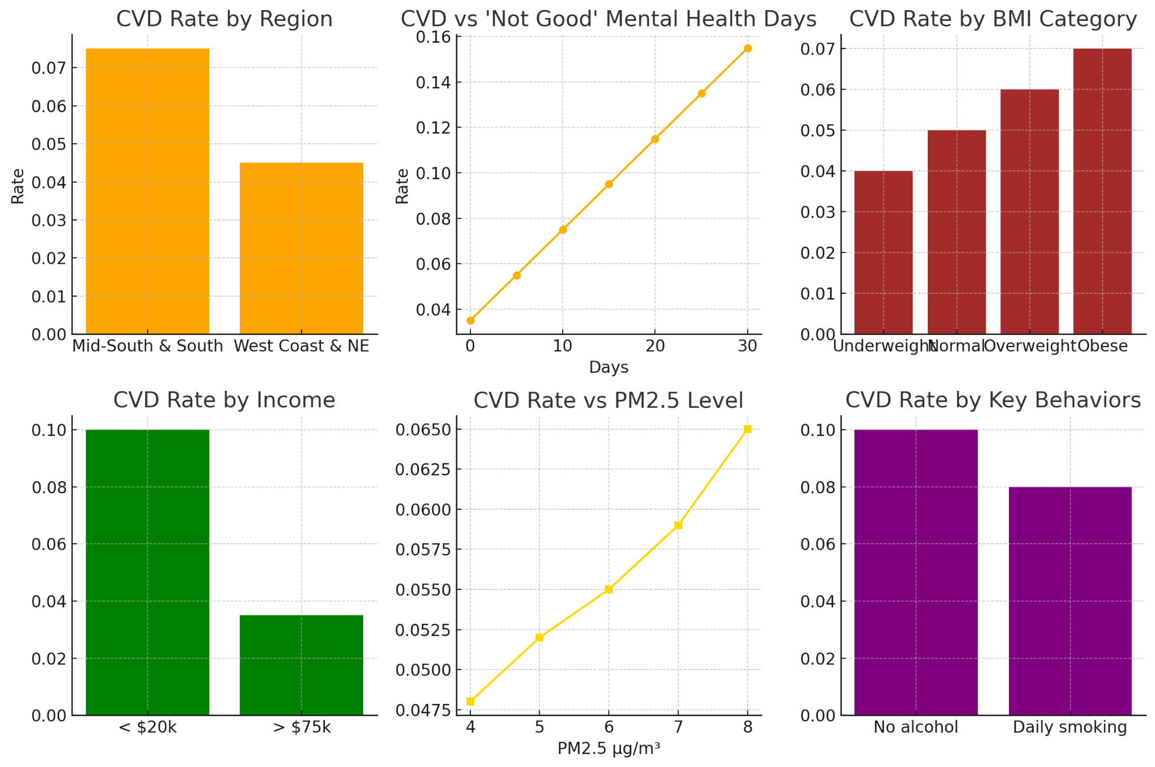
Conclusion
What we found
Mid‑South states (MO, SC, PA) have stroke rates > 8%, vs. ~4.5% on West Coast/NE.
Mental health > 20 “bad” days/month → stroke rate ~8%; Mental health ≤ 5 days → ~3.5%
Obese individuals have the highest stroke rate at ~7.5%, Overweight and Normal‑weight groups follow at ~6.3% and ~4.8%; Underweight individuals show the lowest rate at ~5.5%.
Income < $20k/year → > 10% stroke rate; Income > $75k → ~3%
For air quality, PM2.5 ↑ from 4 to 9 µg/m³ → stroke rate ↑ from ~4.6% to ~6.5%
No exercise → ~8% risk;
daily exercise → ~4.7%

Slide 9
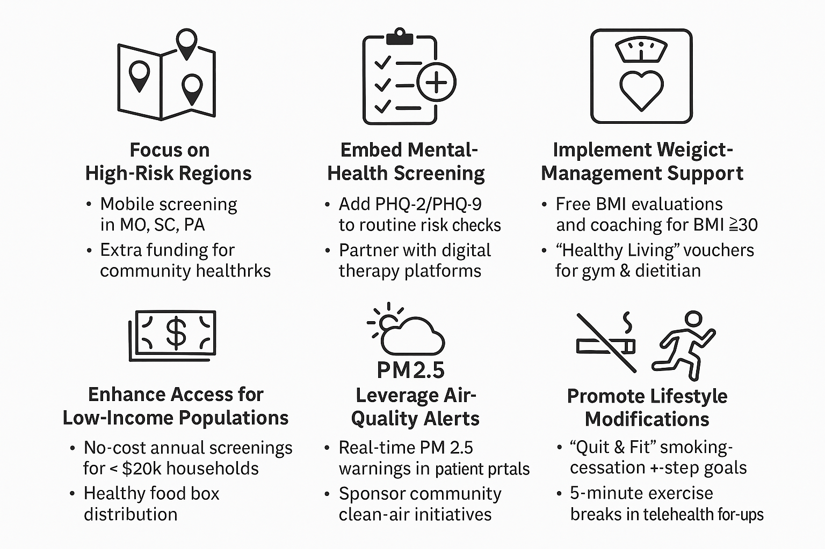
Recommendation

Slide 10
References
BRFSS 2023 Behavioral Risk Factor Surveillance System
EPA Air Quality Index (AQI)
Statista State‑Level GDP Data
County Health Rankings & Roadmaps
Airflow & dbt

